Slide 1
The Polish Righteous – Recalling Forgotten History
Polish Righteous – Recalling Forgotten History
A Story of a House
Exercise 1 - QUIZ

Slide 2
The Polish Righteous – Recalling Forgotten History
Polish Righteous – Recalling Forgotten History
Which European country had the biggest Jewish population before World War II?
  Russia b) Poland
  Germany c) Holland

Slide 3
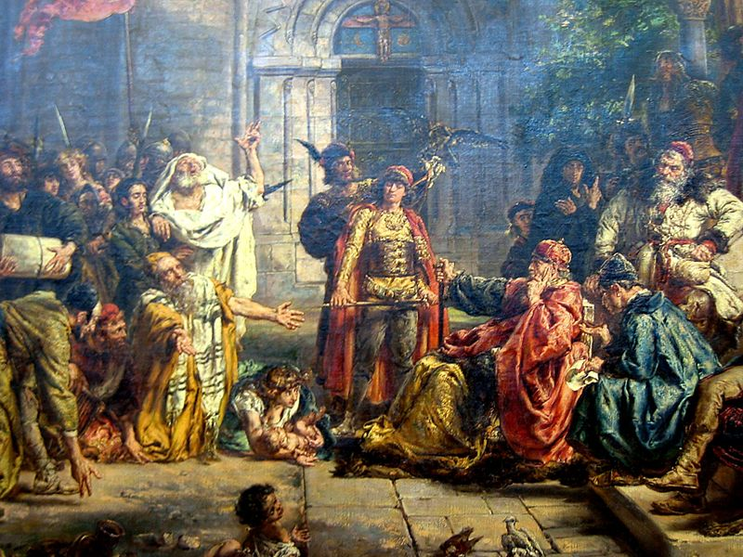
The Polish Righteous – Recalling Forgotten History
Polish Righteous – Recalling Forgotten History
European Jews
before World War II
Before the World War II the biggest Jewish community lived in Poland – ca 3.3 million people, which made 10% of the country population. About 1.5 million Jews lived in Ukraine, ca 1 million in Russia.
The whole population of the European Jews before World War II is estimated at about 9 million.
http://www.wikipedia.pl

Slide 4
The Polish Righteous – Recalling Forgotten History
Polish Righteous – Recalling Forgotten History
2. What percentage of the European Jews
did survive World War II/ Holocaust?
50% b) 72%
c) 12% d) 25%

Slide 5
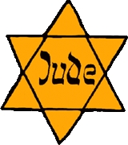
The Polish Righteous – Recalling Forgotten History
Polish Righteous – Recalling Forgotten History
Holocaust / Extermination
As a result of Holocaust, that is mass extermination of Jews during World War II, 75% of the European Jews lost their lives.
90% of the Polish Jews were killed.
http://www.wikipedia.pl

Slide 6
The Polish Righteous – Recalling Forgotten History
Polish Righteous – Recalling Forgotten History
3. Who is a Righteous Among the Nations?
A person who behaves honestly in every situation
A „saint” in the Jewish religion
A person awarded a medal by the institute that commemorates Holocaust
A person who saved Jews during World War II

Slide 7
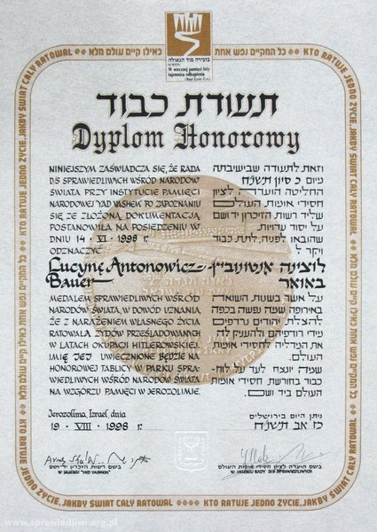
The Polish Righteous – Recalling Forgotten History
Polish Righteous – Recalling Forgotten History
Righteous Among the Nations
People who saved Jews during World War II and for that action were awarded a diploma and medal ‘Righteous Among the Nations’ by the Yad Vashem Institute.

Slide 8
The Polish Righteous – Recalling Forgotten History
Polish Righteous – Recalling Forgotten History
4. Where is the Yad Vashem Institute, commemorating Holocaust, situated?
in Berlin b) in Warsaw
c) in Jerusalem d) in New York

Slide 9
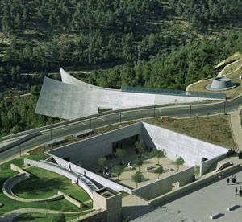
The Polish Righteous – Recalling Forgotten History
Polish Righteous – Recalling Forgotten History
Yad Vashem
Institute founded by the Israeli parliament in 1953 is situated in Jerusalem.
Institute has rich historical collection; it is a modern Museum of Holocaust, and awards people who saved Jews during World War II.
http://www.google.pl

Slide 10
The Polish Righteous – Recalling Forgotten History
Polish Righteous – Recalling Forgotten History
5. Which of the following criteria must be met in order to award someone with the title ‘Righteous Among the Nations’?
The rescuer risked his life, possessions or social position
The rescuer has to be non-Jewish, and his motivation had to be solely the will to save life
An account by the rescued has to be available
All of the above

Slide 11
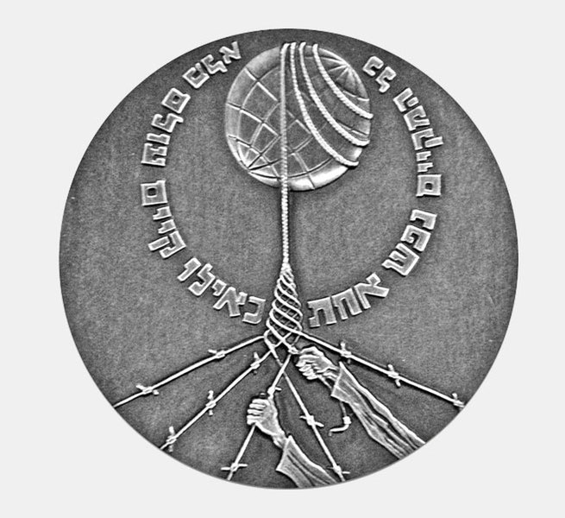
The Polish Righteous – Recalling Forgotten History
Polish Righteous – Recalling Forgotten History
Title of the Righteous Among the Nations
It is awarded to people of non-Jewish origin who actively saved one or more Jewish persons from death or deportation.
Rescuers were threatened with death, losing property or social position.
The only motivation was the will to help and not, e.g., material profit, conversion or child adoption.
Yad Vashem awards their medals based on accounts of those rescued or credible documentation of the fact and conditions of rescue.

Slide 12
The Polish Righteous – Recalling Forgotten History
Polish Righteous – Recalling Forgotten History
6. How many people worldwide have been awarded the title of the Righteous Among the Nations?
23 000 b) 138 000
c) 745 000 d) 2,5 million

Slide 13
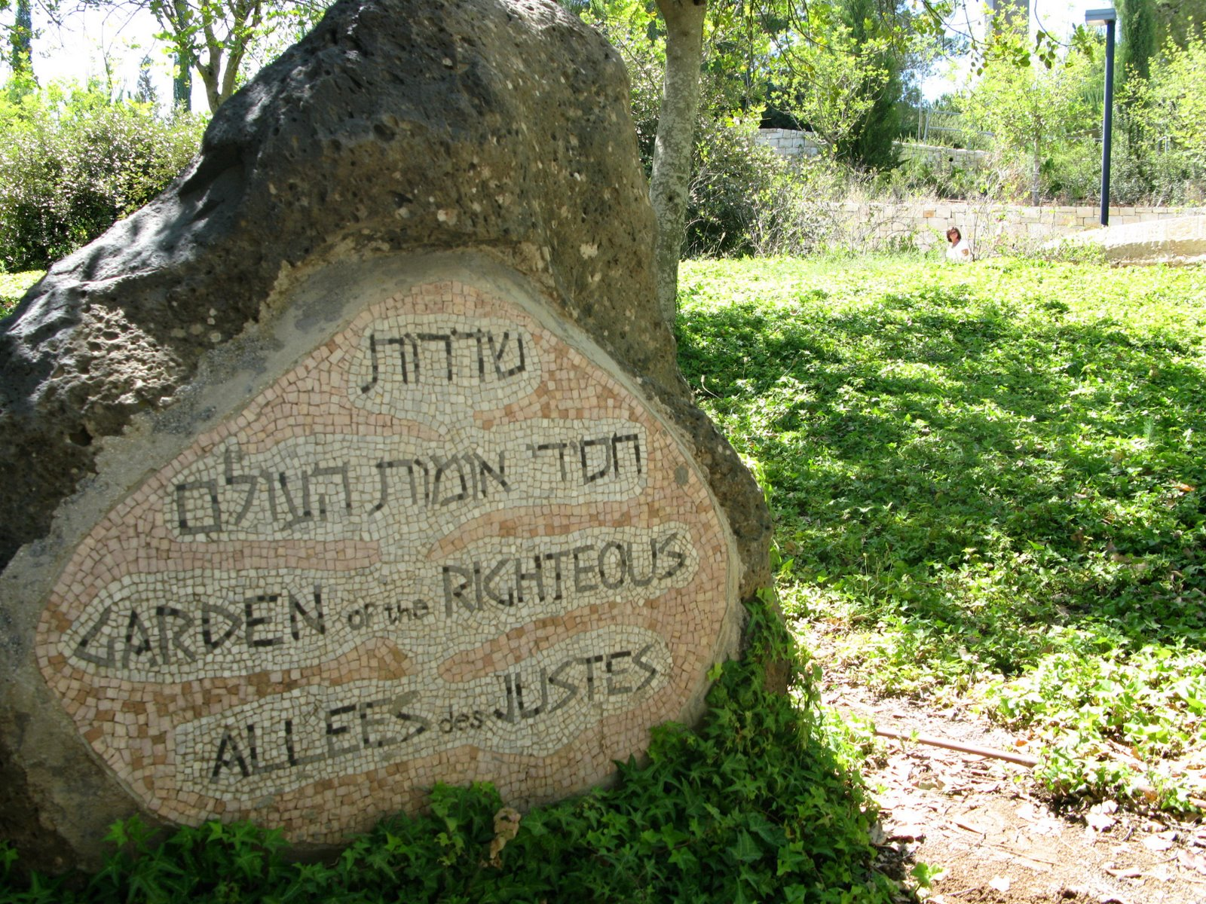
The Polish Righteous – Recalling Forgotten History
Polish Righteous – Recalling Forgotten History
Statistics
According to 2010 data the medal was awarded altogether to 23,226 people from 44 countries of the world
http://www.google.com

Slide 14
The Polish Righteous – Recalling Forgotten History
Polish Righteous – Recalling Forgotten History
7. What 3 countries have the largest number of the Righteous Among the Nations?
Poland, Great Britain, Bulgaria
Poland, Holland, France
Denmark, Bulgaria, Holland
Germany, Denmark, Russia

Slide 15

The Polish Righteous – Recalling Forgotten History
Polish Righteous – Recalling Forgotten History
Statistcs by countries (2010)
Poland 6 195 people
Holland 5 009 people
France 3 158 people
(While comparing those numbers one has to bear in mind differences in the size of Jewish population in different countries as well as harshness of punishment for helping Jews which differed in various countries in occupied Europe)

Slide 16
The Polish Righteous – Recalling Forgotten History
Polish Righteous – Recalling Forgotten History
8. Who of the following have got the title
of the Righteous Among the Nations?
Oskar Schindler, John Paul II, Irena Sendler
Queen Elizabeth of Belgium, Chiune Sugihara, Council for Helping Jews „Żegota”
Raoul Wallenberg, Mother Teresa of Calcutta, members of the Danish resistance movement
All of the above

Slide 17
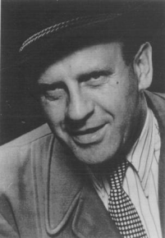
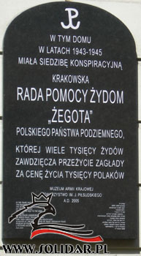
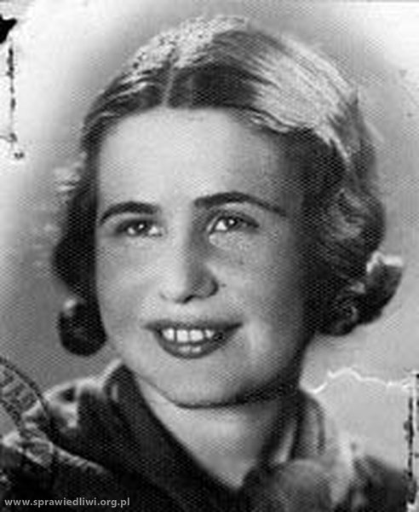
The Polish Righteous – Recalling Forgotten History
Polish Righteous – Recalling Forgotten History
Righteous Among the Nations - examples
Oskar Schindler – German businessman, employed Jews in his factory, thus saving them from deportation.
Council for Helping Jews „Żegota” – Polish undergroud organization, 1942-45, whose aim was rescuing Jews.
http://wikipedia.pl
Irena Sendler – member of „Żegota”, known for rescuing Jewish children she led out of the Warsaw ghetto.

Slide 18
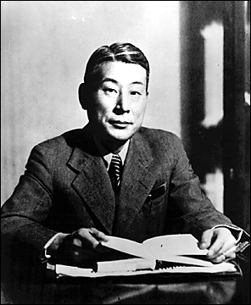
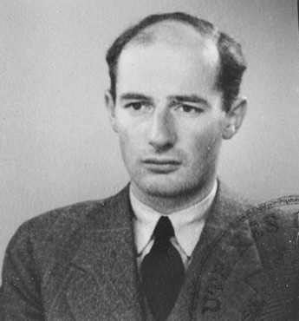
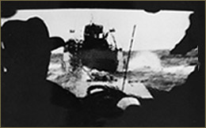
The Polish Righteous – Recalling Forgotten History
Polish Righteous – Recalling Forgotten History
Righteous Among the Nations - examples
http://wikipedia.pl
Raoul Wallenberg – Swedish diplomat, rescued Jews in Hungary.
Chiune Sugihara – diplomat, during World War II posted in Lithuania, issued Japanese passports to Jewish refugees.
http://wikipedia.pl
http://www.ushmm.org
Denish resistance movement – 99% Danish Jews were rescued through organizing their evacuation to neutral Sweden.

Slide 19
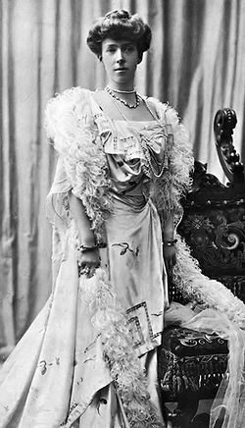
The Polish Righteous – Recalling Forgotten History
Polish Righteous – Recalling Forgotten History
Righteous Among the Nations - examples
It should be remembered, that apart from those well-known examples of help provided by diplomats and institutions, majority of Righteous Among the Nations are individual, „ordinary” people
Queen Elizabeth of Belgium – during occupation helped save hundreds of Jewish children from deportation
http://wikipedia.pl

