Slide 1
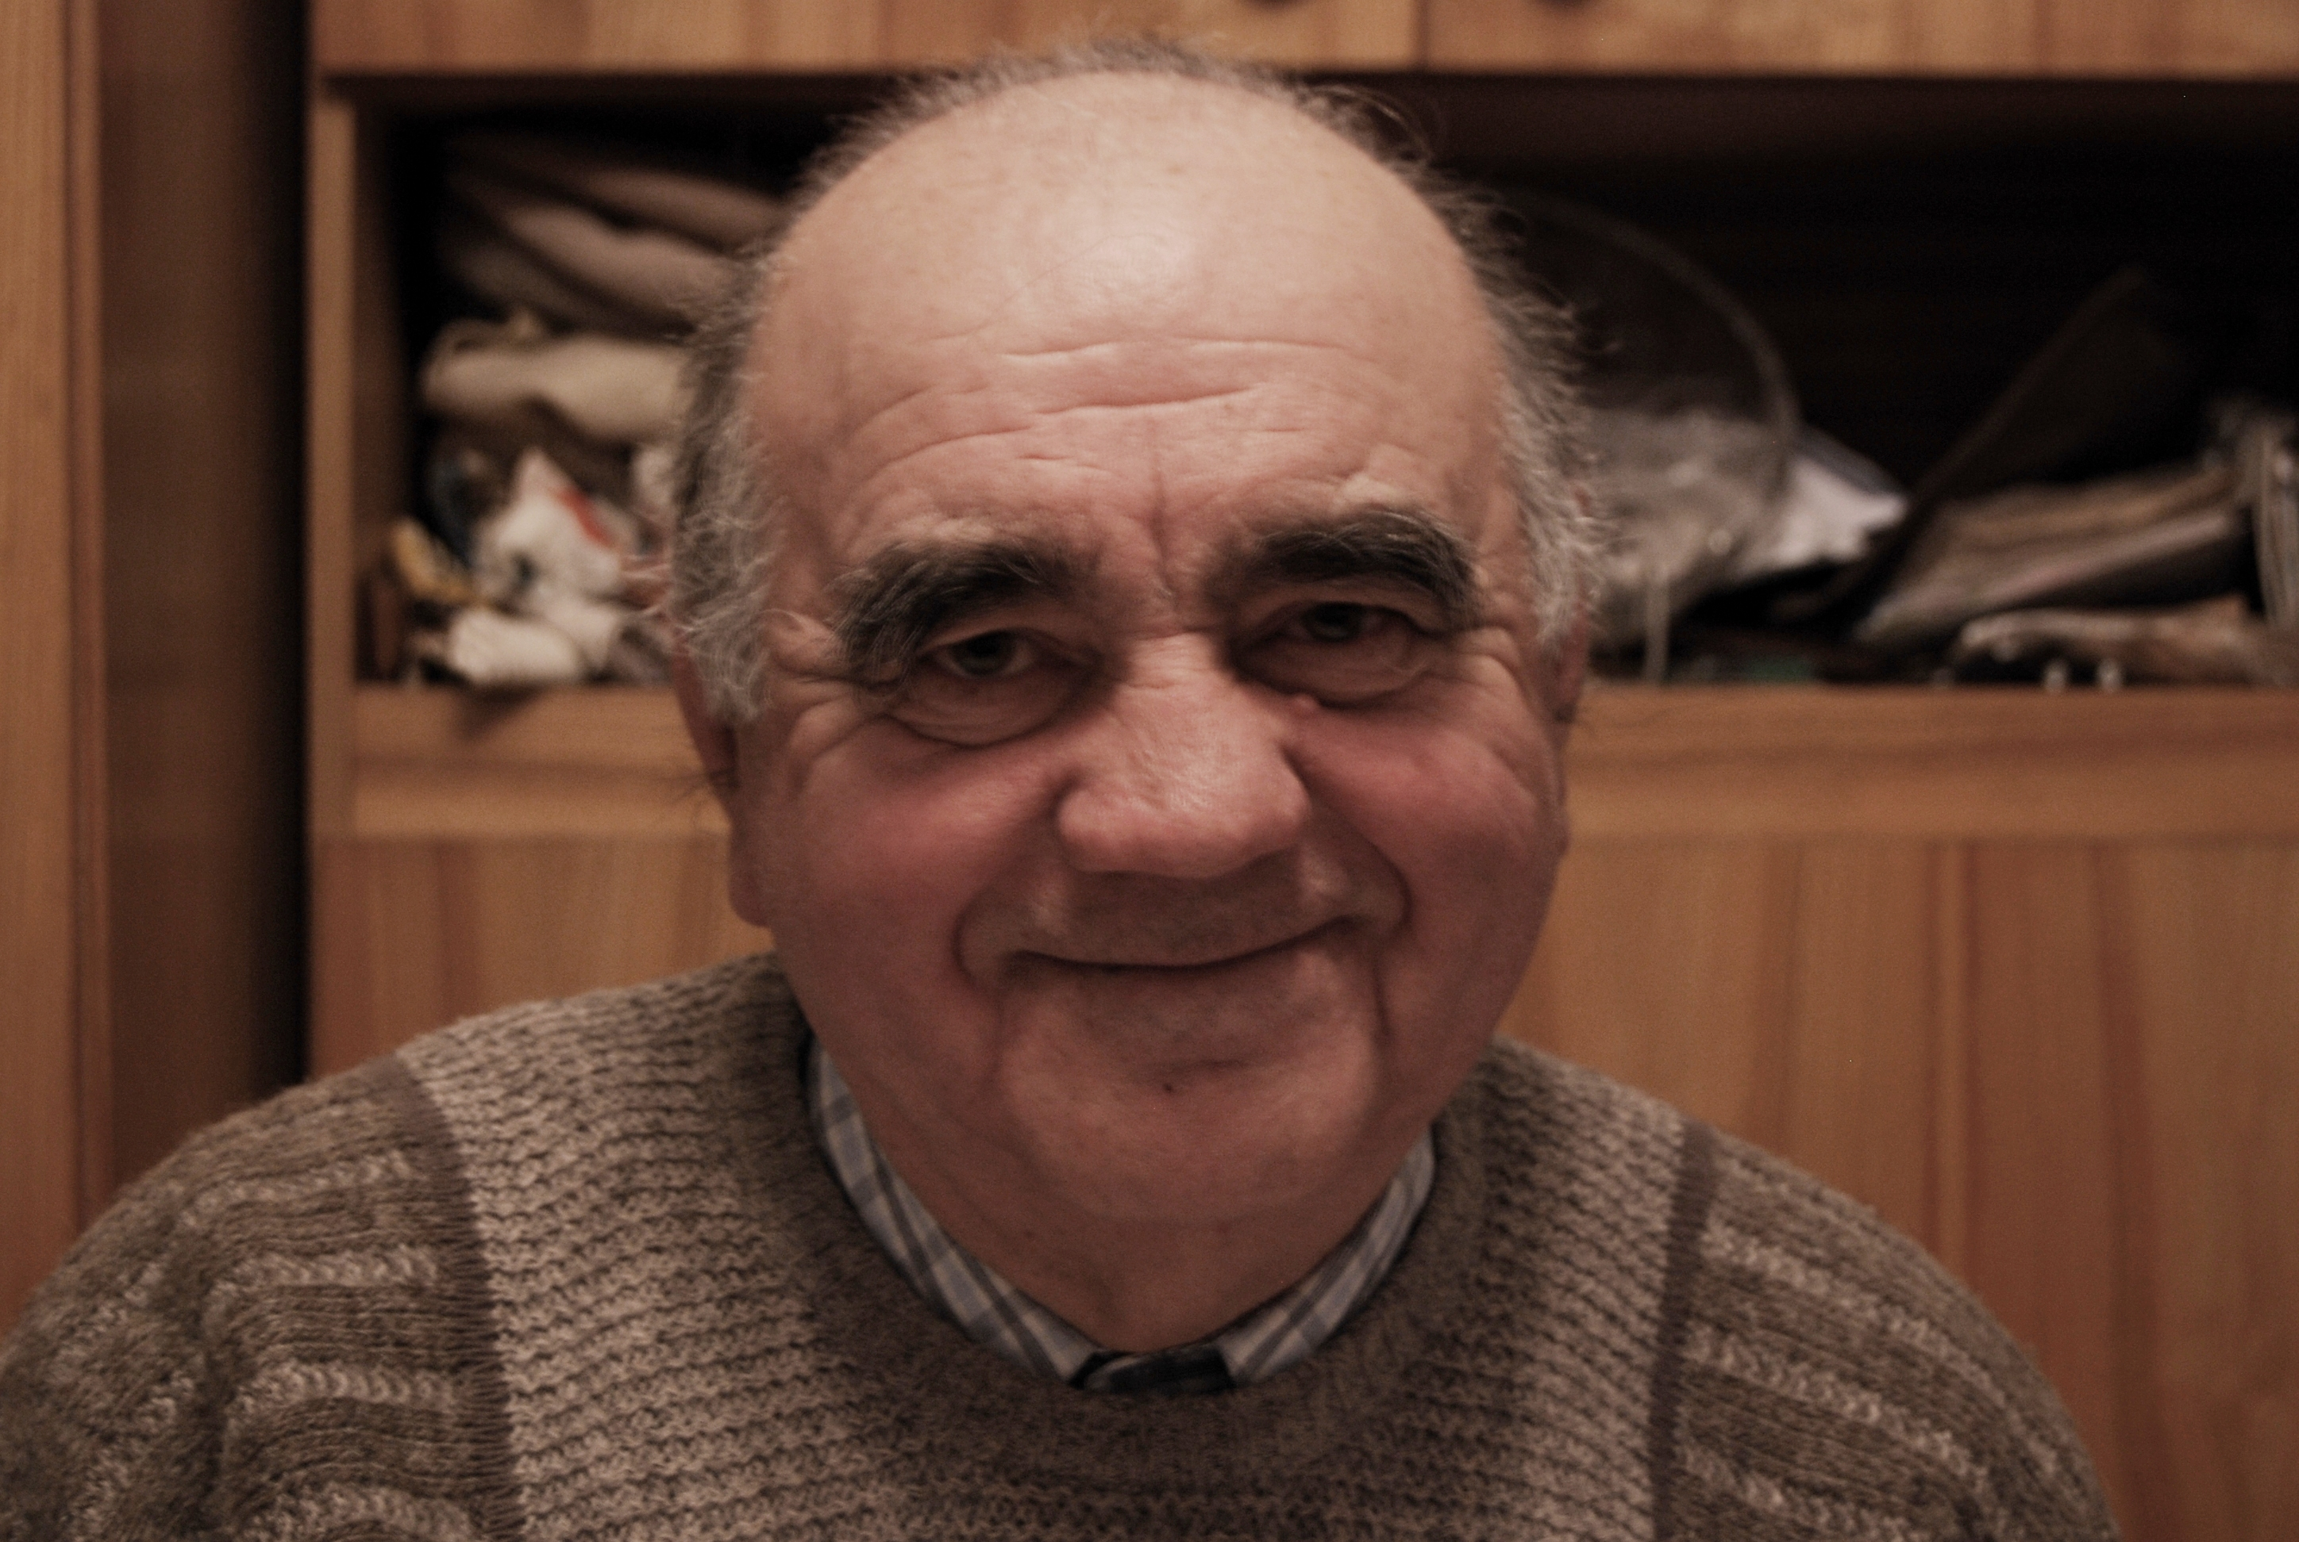
The Polish Righteous – Recalling Forgotten History
Polish Righteous – Recalling Forgotten History
Alfred Kwarciak – the Righteous - 2010

Slide 2
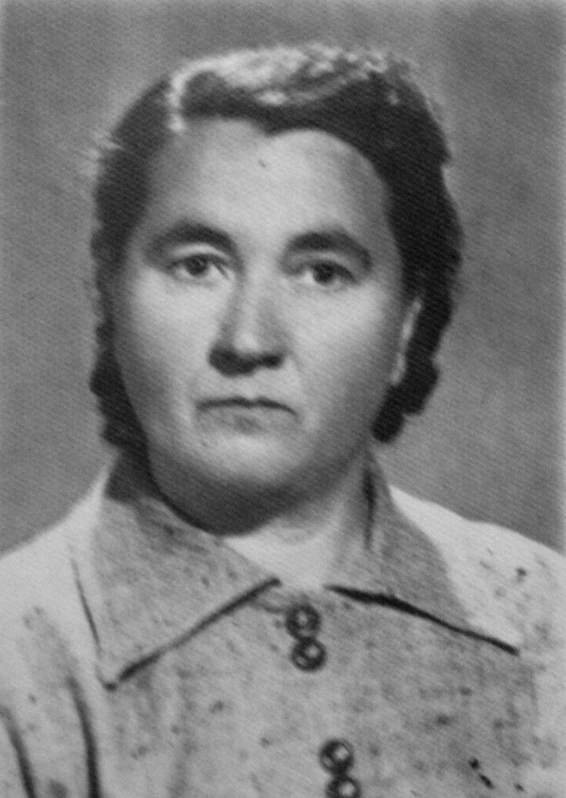
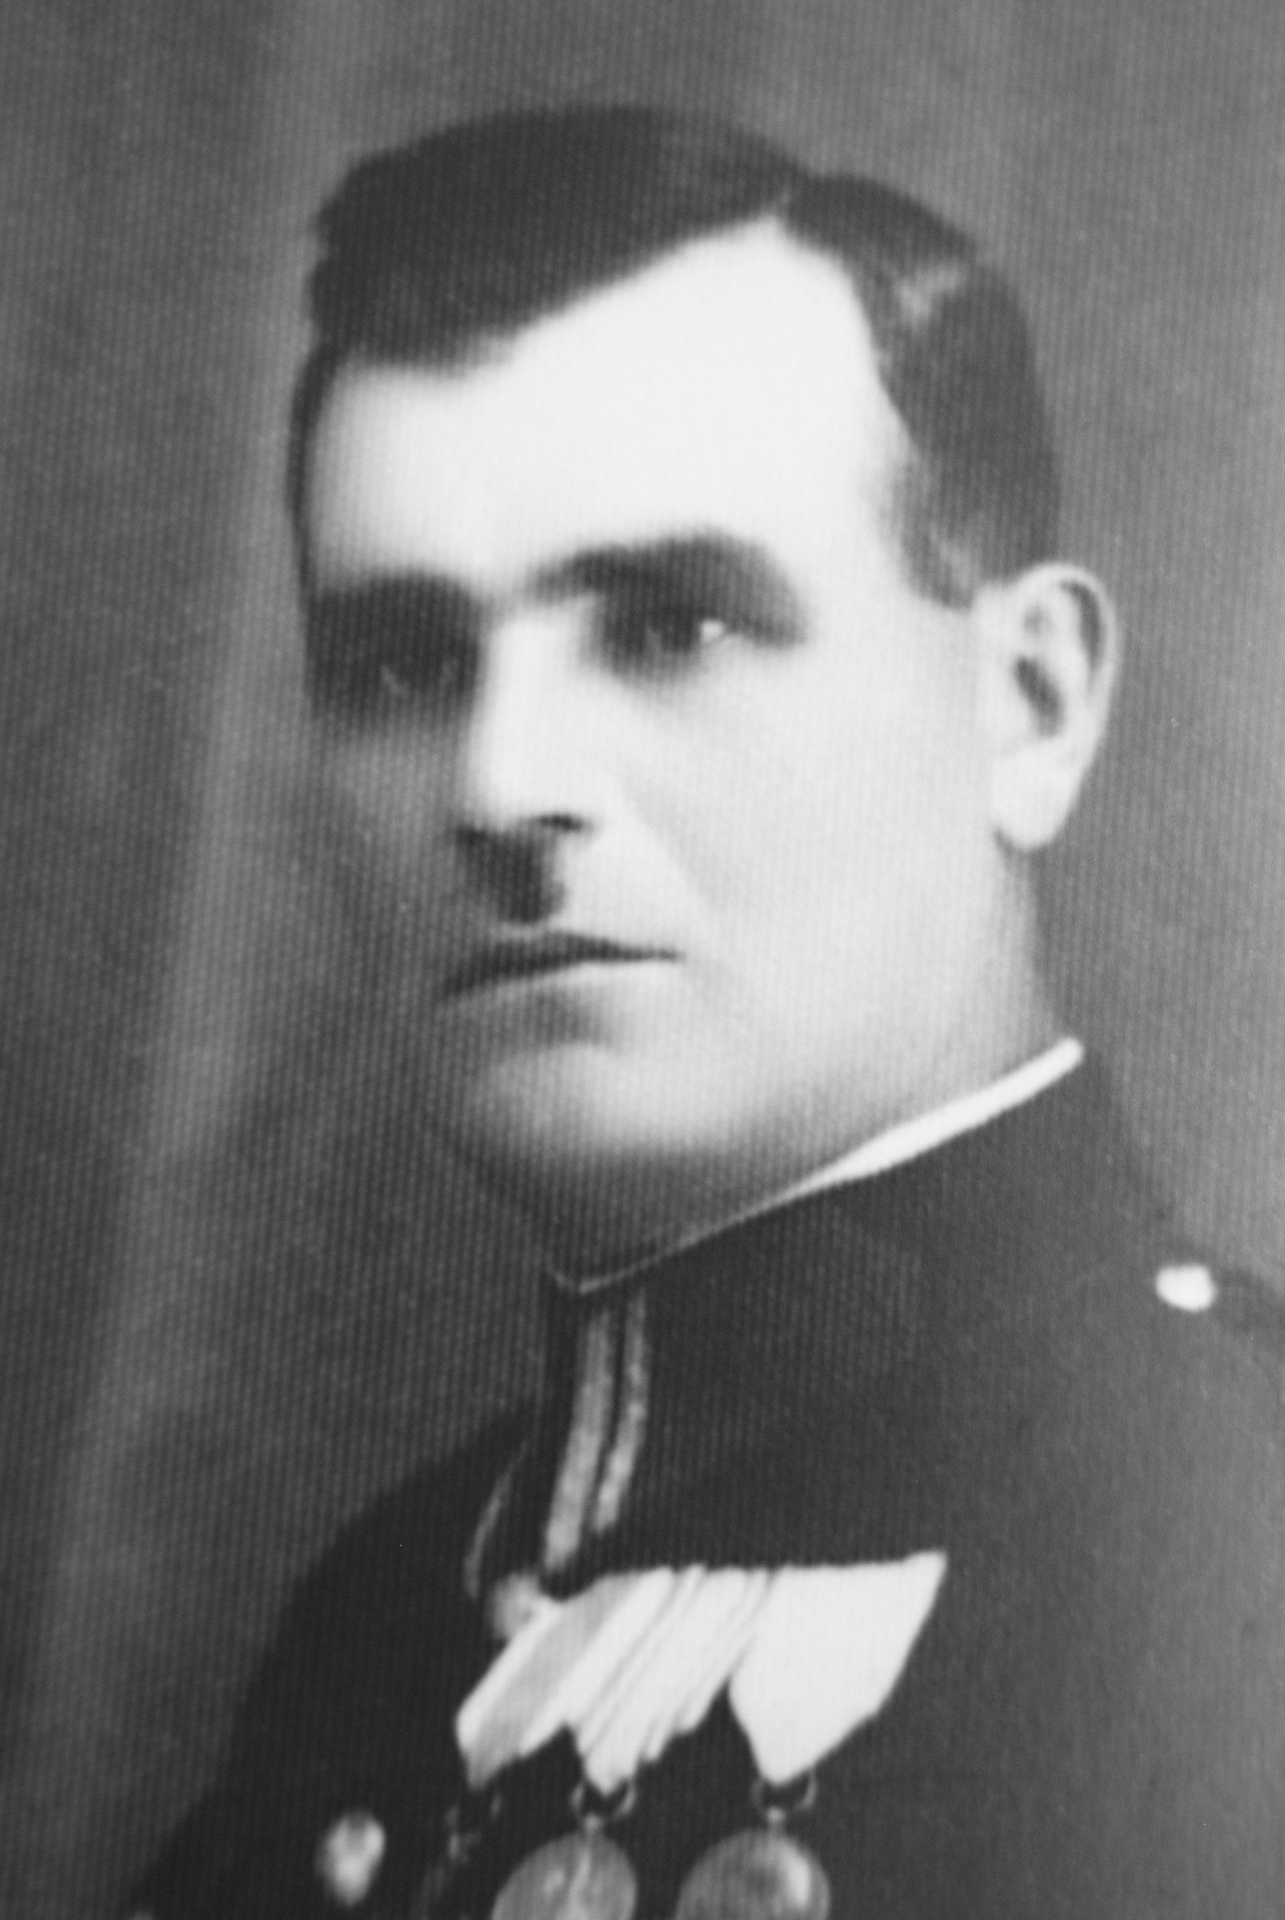
The Polish Righteous – Recalling Forgotten History
Polish Righteous – Recalling Forgotten History
Maria Kwarciak – the Righteous
Piotr Kwarciak – the Righteous

Slide 3
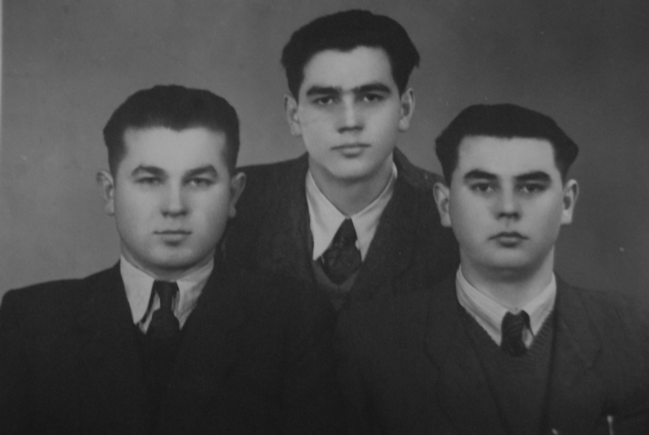
The Polish Righteous – Recalling Forgotten History
Polish Righteous – Recalling Forgotten History
Alfred, Feliks and Anatoliusz Kwarciak – the Righteous - in the 70’s

Slide 4
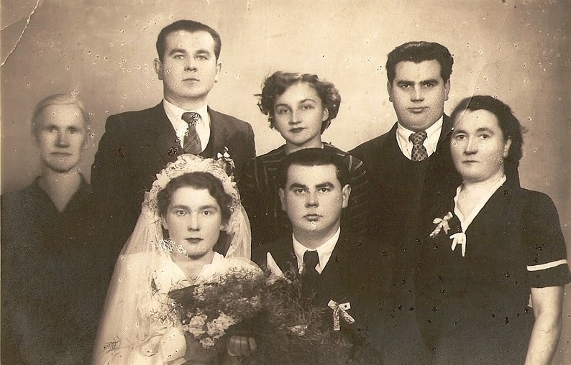
The Polish Righteous – Recalling Forgotten History
Polish Righteous – Recalling Forgotten History
Feliks and Henryka Kwarciak’ s wedding photography

Slide 5
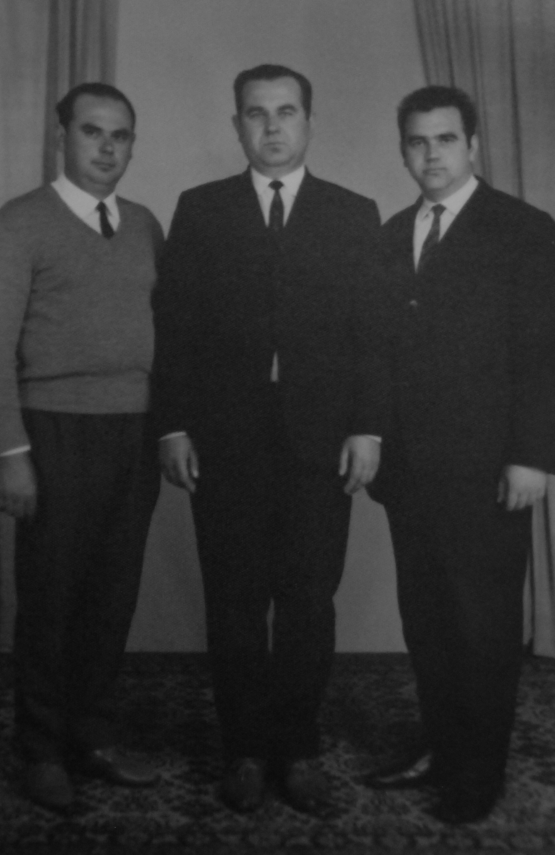
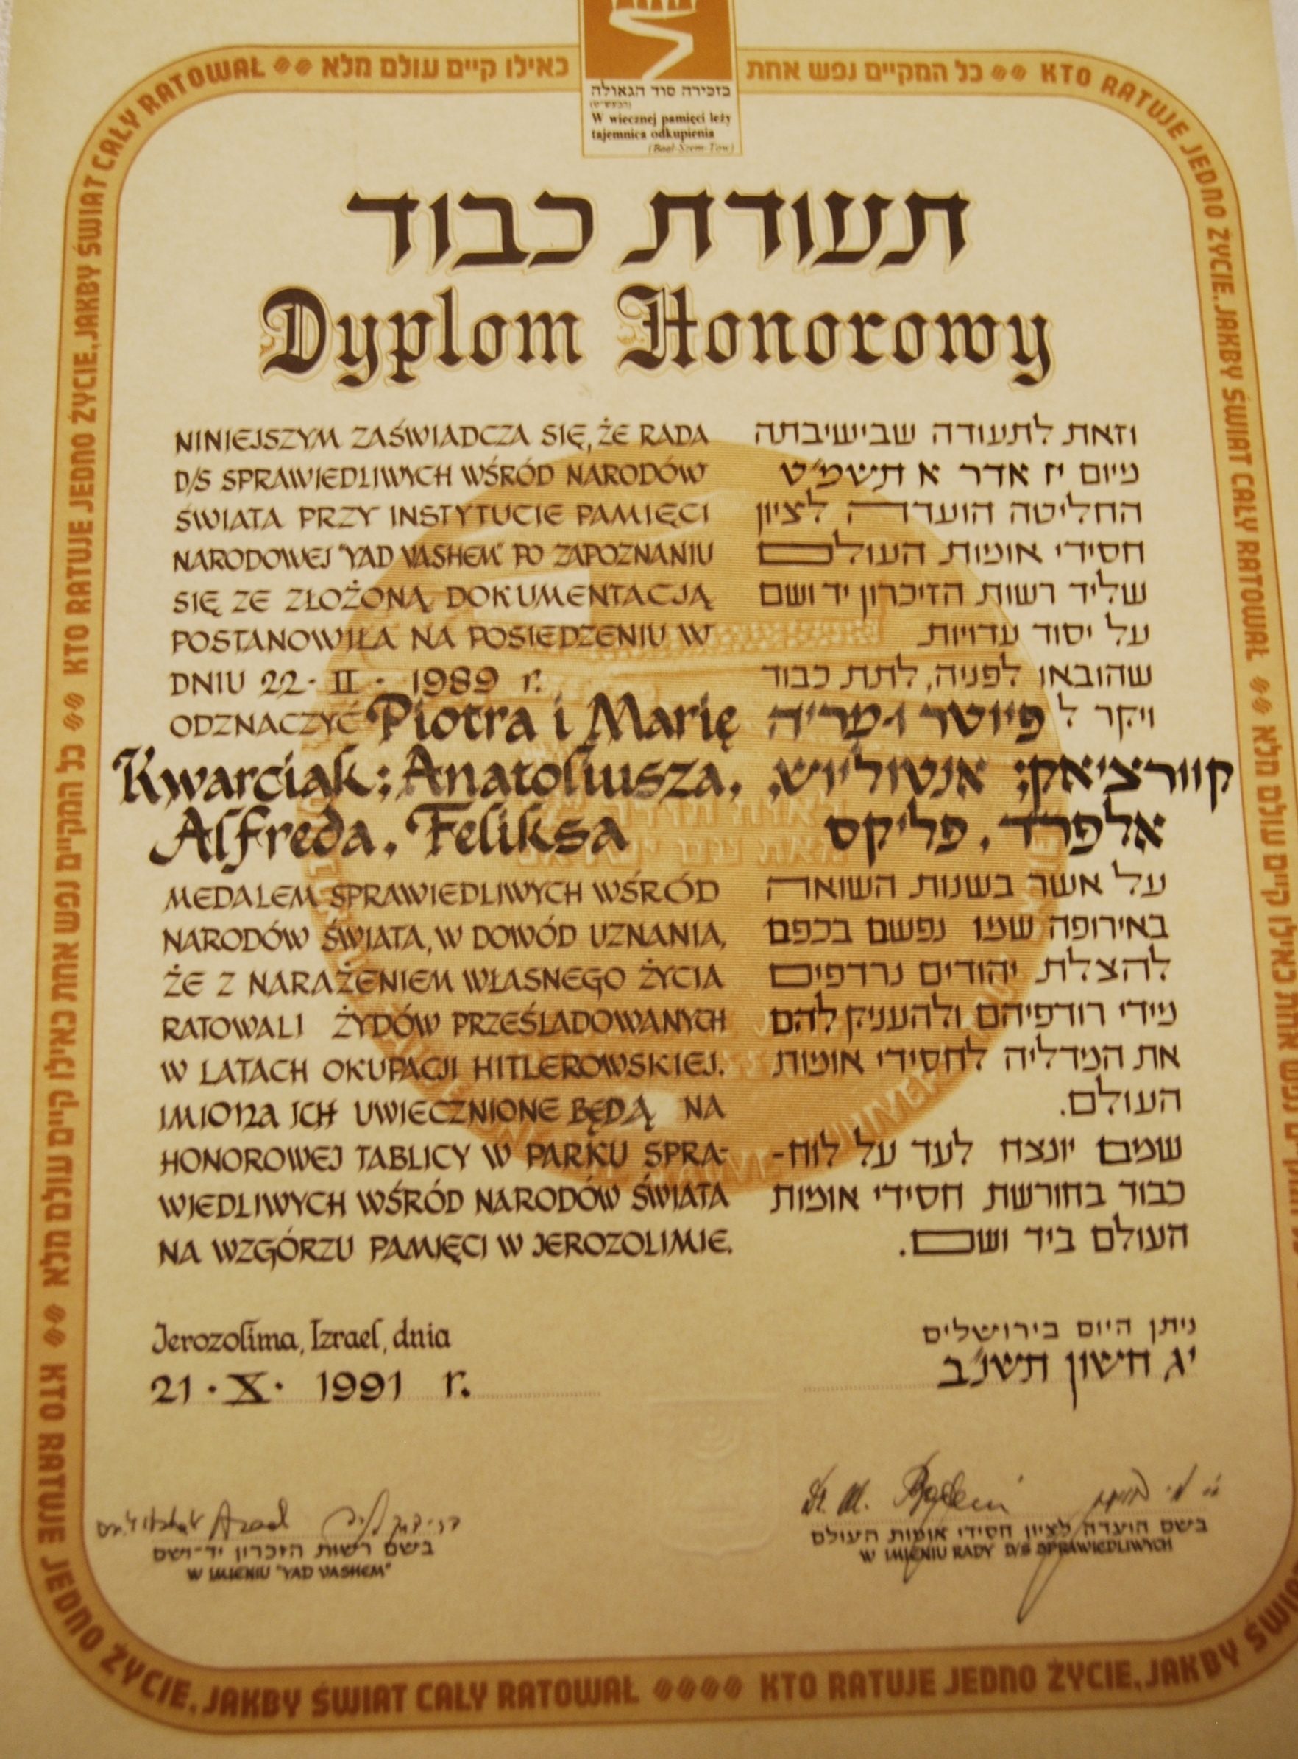
The Polish Righteous – Recalling Forgotten History
Polish Righteous – Recalling Forgotten History
Alfred, Feliks and Anatoliusz Kwarciak – the Righteous - in the 70’s
Yad Vashem Diploma

Slide 6
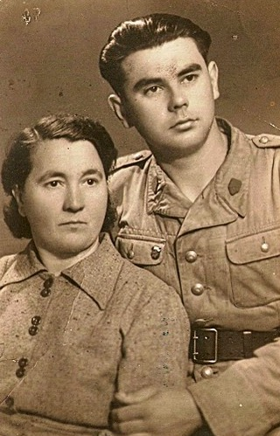
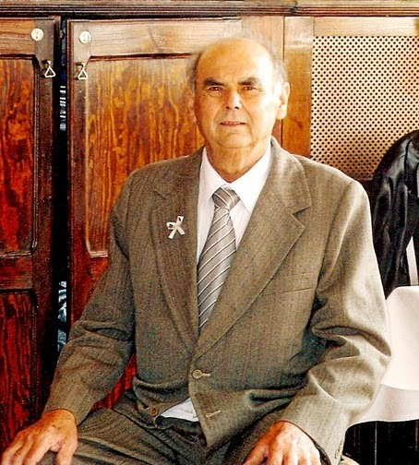
The Polish Righteous – Recalling Forgotten History
Polish Righteous – Recalling Forgotten History
Feliks Kwarciak with his mother Maria – the Righteous
Feliks Kwarciak – the Righteous

Slide 7
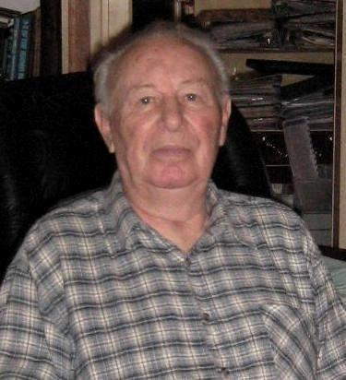
The Polish Righteous – Recalling Forgotten History
Polish Righteous – Recalling Forgotten History
Michał Fiszer – the Survivor – 2010

Slide 8
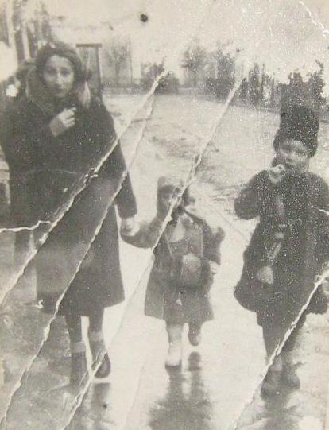
The Polish Righteous – Recalling Forgotten History
Polish Righteous – Recalling Forgotten History
Michał and Leja Fiszer – the Survivors – with their aunt

Slide 9
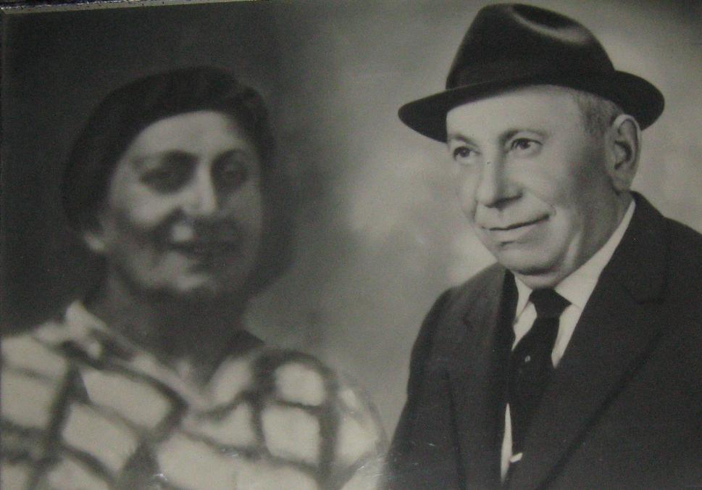
The Polish Righteous – Recalling Forgotten History
Polish Righteous – Recalling Forgotten History
Icchak Licman – the Survivor – with his wife

Slide 10
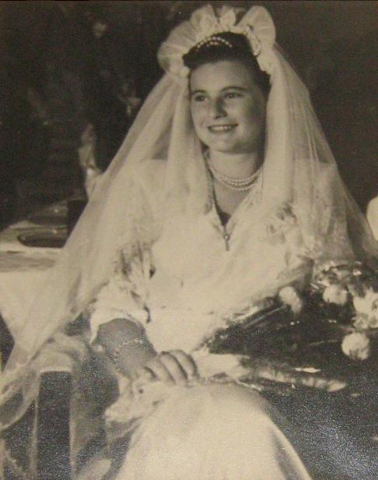
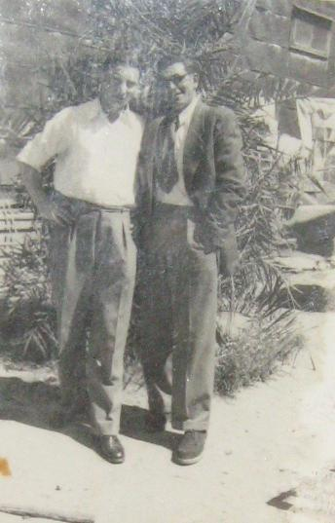
The Polish Righteous – Recalling Forgotten History
Polish Righteous – Recalling Forgotten History
Leja Fiszer – the Survivor - 1953
Michał Fiszer – the Survivor - Israel 1948

Slide 11
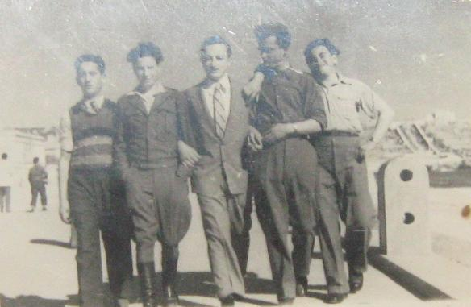
The Polish Righteous – Recalling Forgotten History
Polish Righteous – Recalling Forgotten History
Michał Fiszer (second from the left) – the Survivor - Italy 1946

Slide 12
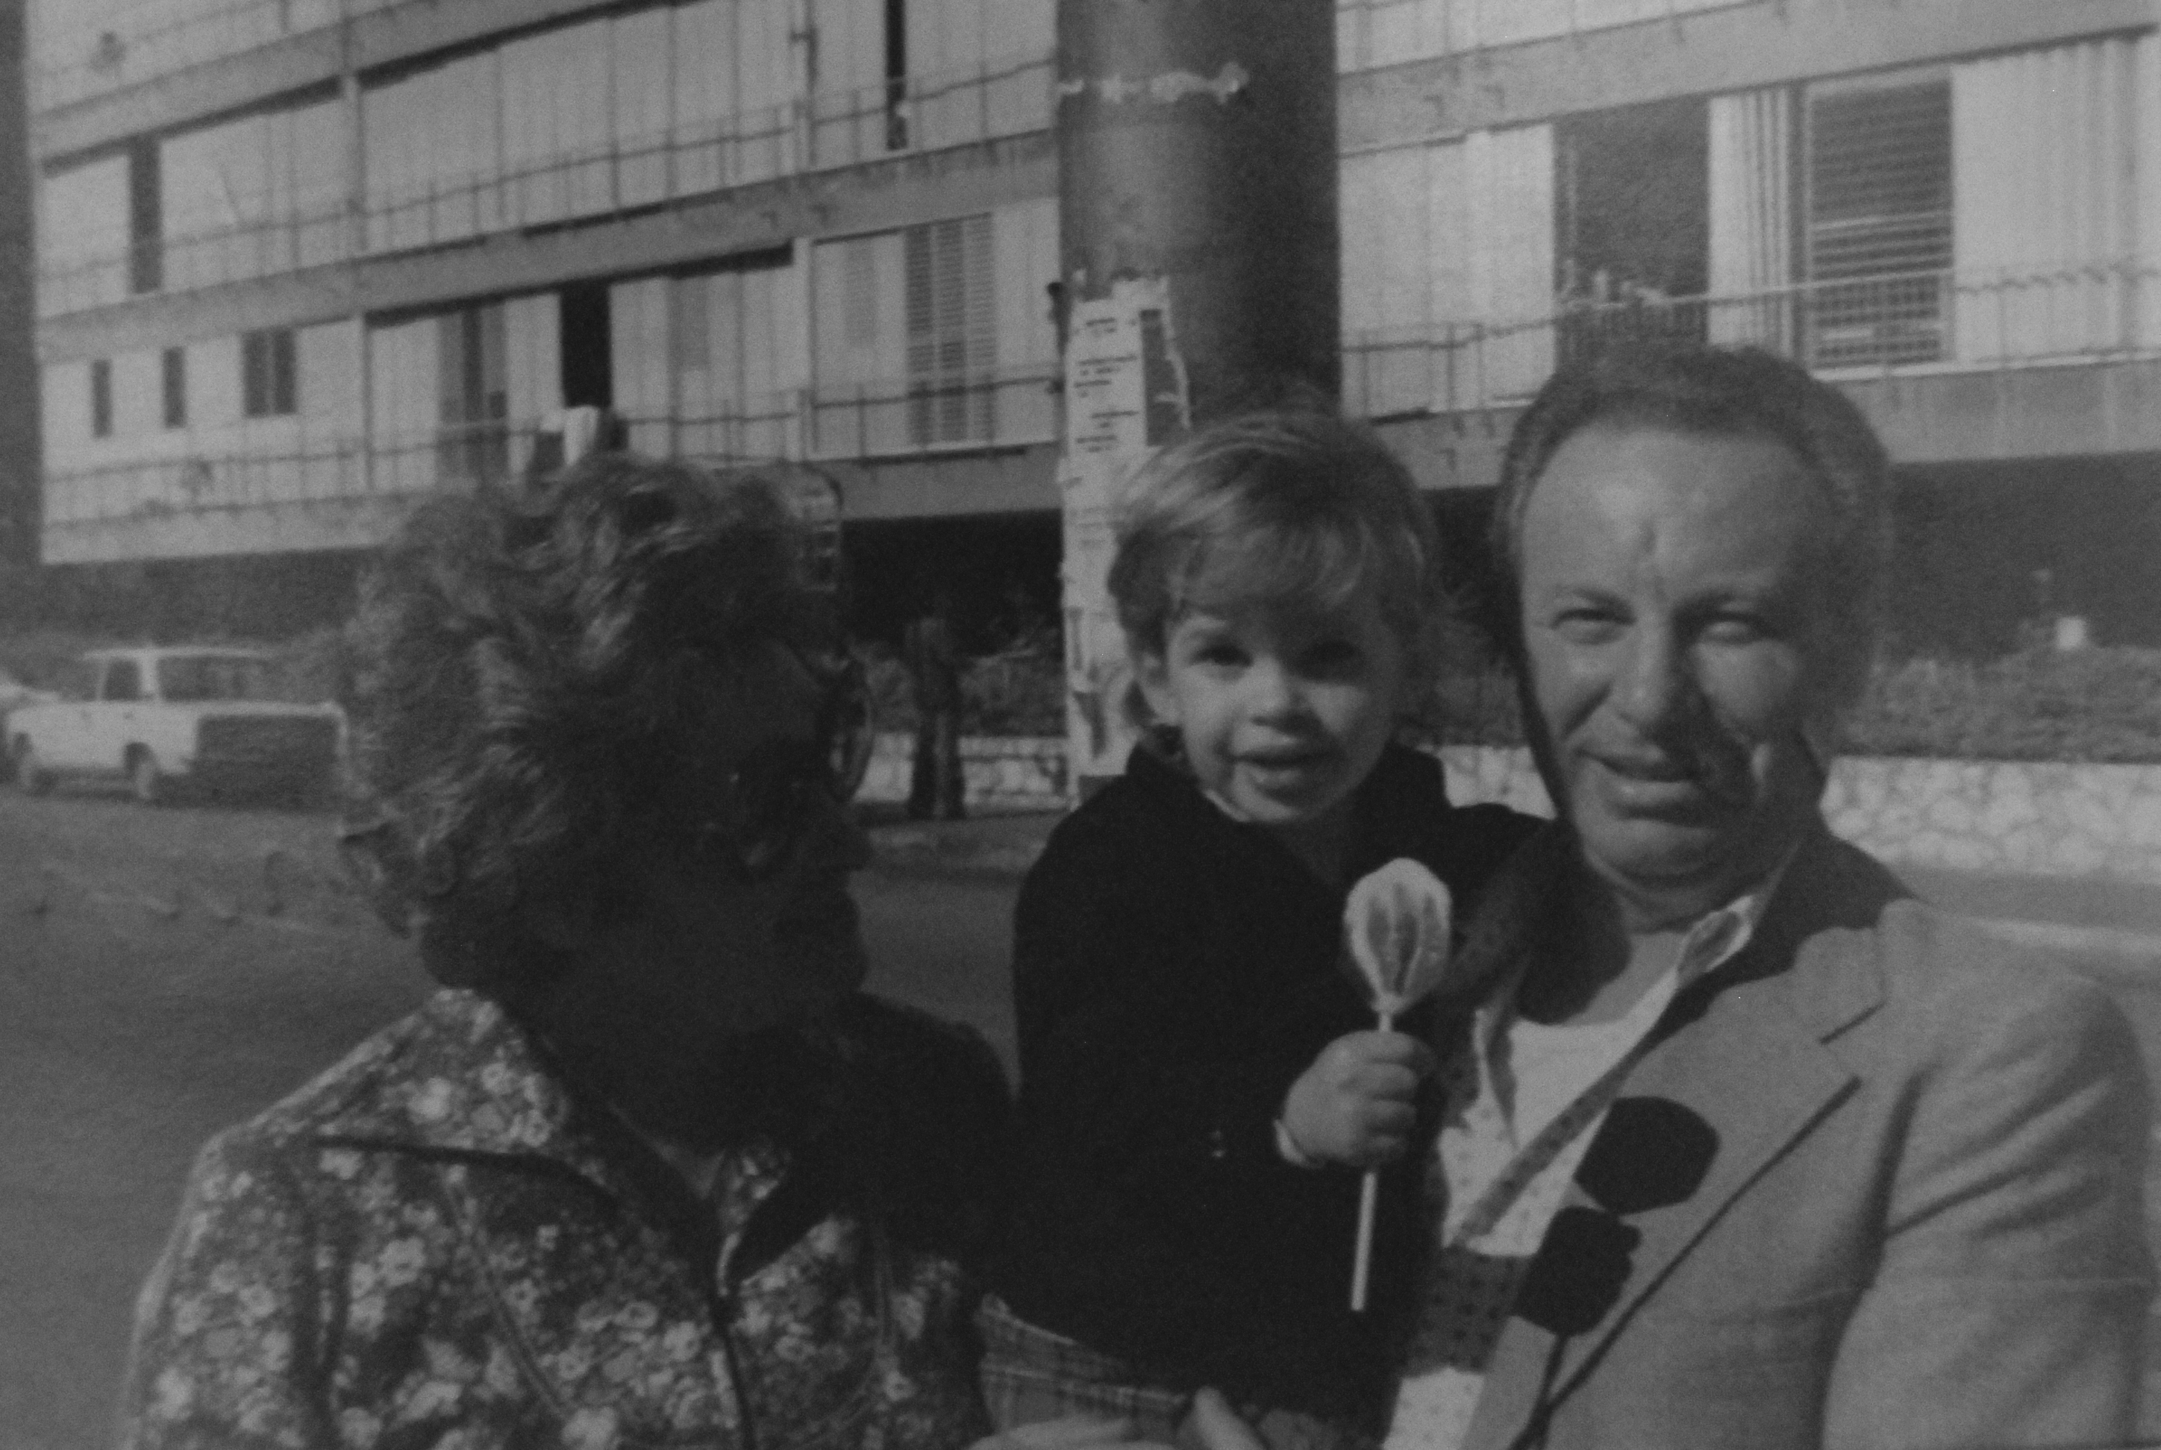
The Polish Righteous – Recalling Forgotten History
Polish Righteous – Recalling Forgotten History
Michał Fiszer – the Survivor – with his wife and a grandson

